Slide 1
IP-cores and Design Reuse
CE233(CAD), Lecture 12:
Mehdi Modarressi
Department of Electrical and Computer Engineering,
University of Tehran

Slide 2
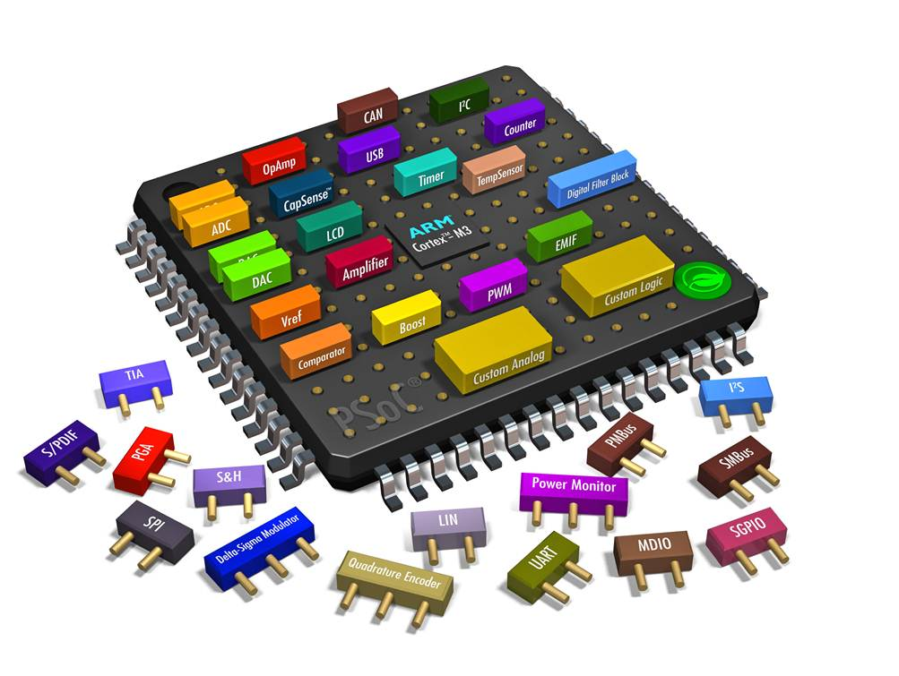
Introduction
Introduction to SoCs
Design reuse and IP-cores
Picture source: http://www.cypress.com

Slide 3
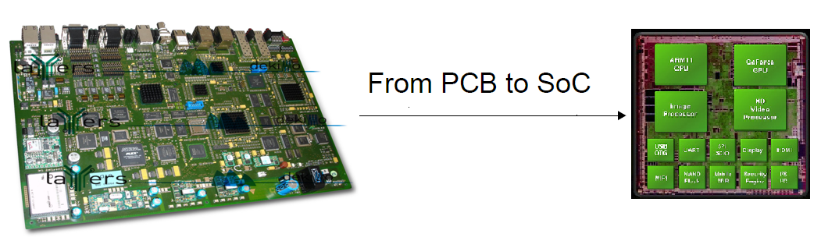
Introduction
Advances in semiconductor technology
  Today’s chip can contains 50 billion transistors
The consequences
  Components connected on a printed circuit board can now be integrated onto single chip
  Emergence of systems-on-chip
Picture source: www.xbitlabs.com

Slide 4
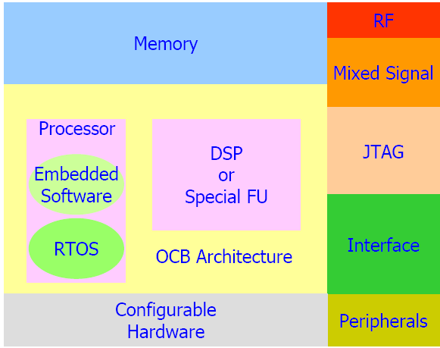
SoC
An SoC may contain
  Custom hardware blocks
    A.K.A. Hardware accelerator
  DSP blocks
  Embedded CPU
  Embedded Memory
  Real World Interfaces (USB, PCI, Ethernet)
  Software (both OS and Applications)
  Mixed-signal Blocks
    DAC, ADC
  FPGAs
Notes:
The class and the labs will provide you with the opportunity to create an embedded design.

Slide 5
SoC benefits
Reduce size
Low cost
Reuse
Low power
High performance
High reliability

Slide 6
SoPC
System-on-Programmable Chip (SoPC): FPGA vendors provide an SoC on an FPGA chip
In addition to configurable part there are also:
  Processor cores
  Peripherals
  On-chip buses
  DSP blocks
  A rich range of soft IP cores as a library can be implemented on the configurable part
  Operating systems and software drivers
  …

Slide 7
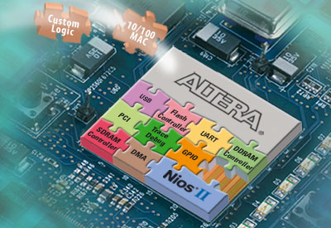
SoPC
Xilinx SoPCs:
  2 or 4 PowerPC 405 and 440 cores and many peripherals
  Xilinx EDK for development
Altera SoPCs:
  NIOS II or ARM Cortex cores and many peripherals
    ARM Cortex is a dual core processor
  Altera SoPC Builder for development
Picture source: http://www.altera.com
Notes:
The class and the labs will provide you with the opportunity to create an embedded design.

Slide 8


Altera Startix
32-bit embedded NIOS-II processor
CUSTOM
INSTR IF
TCM
I-MEM
TCM
D-MEM
I$
D$
INT
CNTRL
MMU
MPU
EXP
CNTRL
Debug
JTAG
DEBUG
HW
BP
I & D
TRCE
TRCE
PORT
FPGA
Your design here
Picture source: http://www.altera.com
Notes:
Nios has been one of Altera’s most successful products
Over 20,000 Nios Development Kits have been shipped

Slide 9
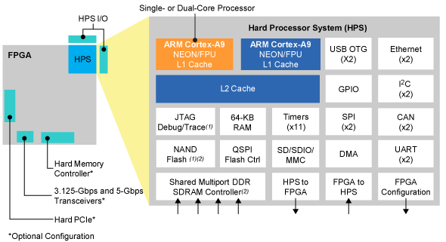
Altera Cyclone V
Integrate an ARM-based hard processor system (HPS) consisting of processor, peripherals, and memory interfaces with the FPGA fabric
Picture source: http://www.altera.com

Slide 10
Xilinx SoPCs
Some Xilinx FPGA families have a processor core and a large selection of components
Example: Virtex-II family of Xilinx FPGAs has one PPC-405 core
  A large variety of peripherals
  Uses IBM CoreConnect bus
    Fast PLB : Processor Local Bus
    Slower OPB : On-chip Peripheral Bus
Xilinx EDK tool to program these SoPCs

Slide 11
PowerPC-based Virtex-II
RocketIO
DSOCM
BRAM
(32 bit)
Dedicated Hard IP
ISOCM
BRAM
(64 bit)
PowerPC
405 Core
Flexible Soft IP
IBM CoreConnect™
on-chip bus standard
PLB, OPB, and DCR
I Cache
D Cache
DCR Bus
PLB
OPB
Arbiter
Processor Local Bus
Bus
Bridge
On-Chip Peripheral Bus
Arbiter
e.g.
Memory
Controller
Hi-Speed
Peripheral
GB
E-Net
UART
GPIO
On-Chip
Peripheral
Off-Chip
Memory
ZBT SRAM
Full system customization to meet
performance, functionality, and
cost goals
DDR SDRAM
SDRAM
Picture source: http://www.xilinx.com
Notes:
Build DSOCM and ISOCM—The PowerPC™ 405 core is provided with non-bused, non-cacheable, low-latency data and instruction memory interfaces, known as the 32-bit data-side On-Chip Memory and the 64-bit instruction-side On-Chip Memory. Typical uses of data-side OCM include scratch-pad memory and using the dual-port feature of block RAM to enable a bidirectional data transfer between the processor and the FPGA. The typical use for instruction-side OCM is storage of interrupt service routines. One of the primary advantages of OCM is that it guarantees a fixed latency of execution because there is no bus arbitration required for the OCM interface. Also, it reduces cache pollution and thrashing, because the cache remains available for caching code from other memory resources.
Build PLB—The processor local bus (PLB) interface provides a 32-bit address and three 64-bit data buses attached to the instruction-cache and data-cache units. Two of the 64-bit buses are attached to the data-cache unit, one supporting read operations and the other supporting write operations. The third 64-bit bus is attached to the instruction-cache unit to support instruction fetching. The prime goal of the PLB is to provide a high-bandwidth, low-latency connection between bus agents that are the main producers and consumers of the bus transaction traffic. This is the bus to which you connect your higher speed peripherals (e.g., G-Ethernet Mac) and memory.
Build OPB—The On-chip Peripheral Bus (OPB) provides a fully synchronous 32-bit address and 32-bit data bus. The prime goal of the OPB is to provide a flexible connection path to peripherals and memory, while providing minimal performance impact to the PLB bus. Put your slower peripherals on this bus, such as UARTs, GPIO, 10/100 E-Net MAC, etc.
Build DCR—The DCR (Device Control Register) bus is a 32-bit bus for removing device configuration slave loads, memory address resource use, and configuration transaction traffic from the main system buses. Most traffic on the DCR bus occurs during the system initialization period; however, some elements, such as the DMA controller and the interrupt controller cores, use the DCR bus to access normal functional registers used during operation.

Slide 12
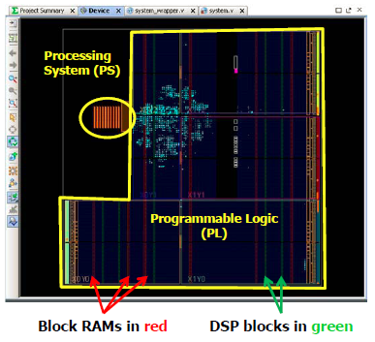
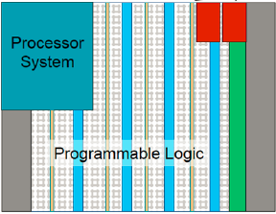
Xilinx Zynq
A modern SoPC with many hardcore logic

Slide 13
Xilinx Zynq
FPGA fabric with embedded ARM processor on single die
  Programmable logic (PL)
  Processing system (PS)
PS based on dual-core ARM Cortex-A9
  A rich set of peripherals: USB, CAN, SPI, Flash memory interface, DAM controller, memory controller, …..

Slide 14
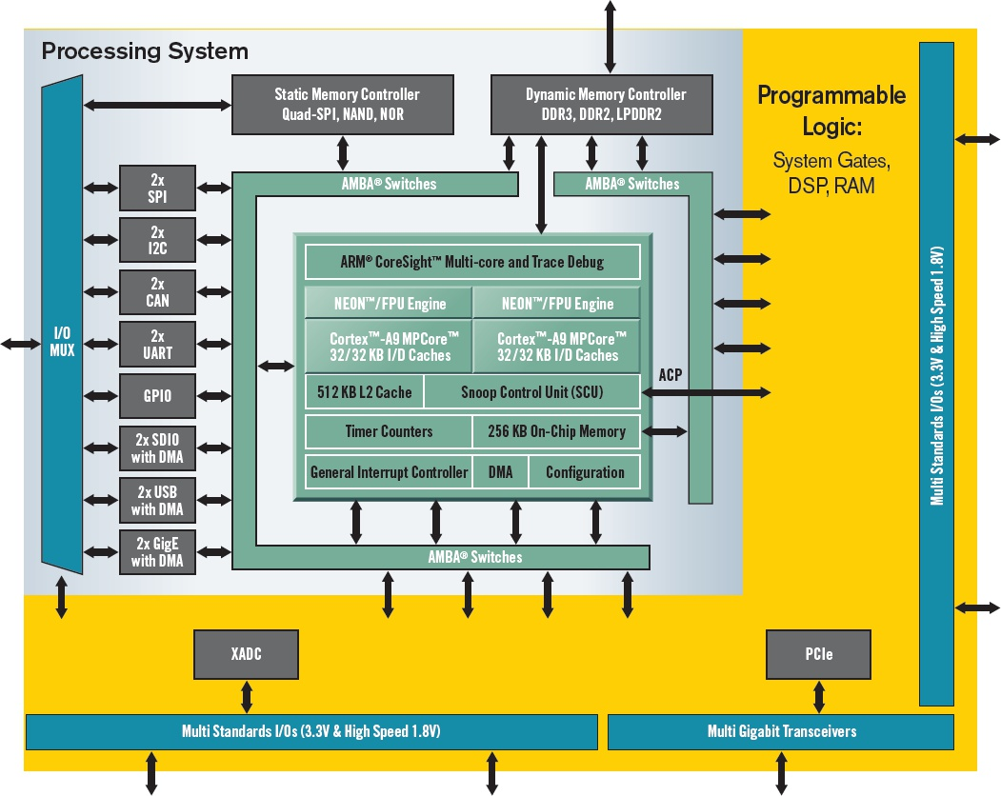
Zynq FPGA block diagram
FPGA (yellow part) and ARM processor on the same chip

Slide 15
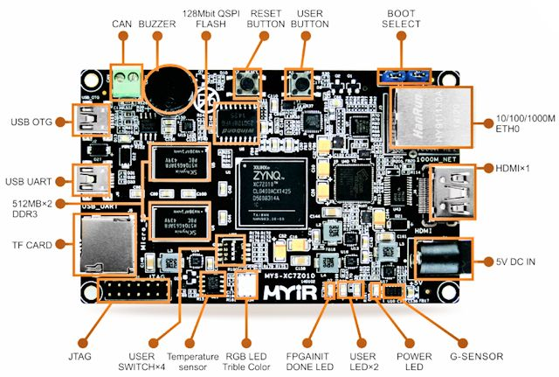
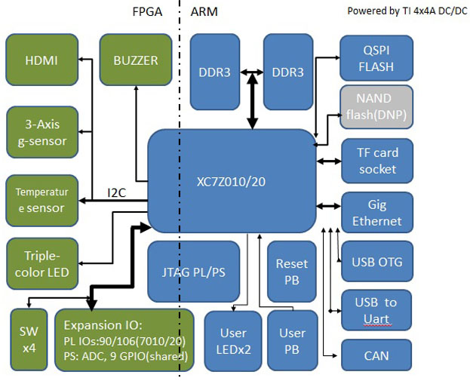
Zynq boards: Z-turn
A compact powerful computer

Slide 16
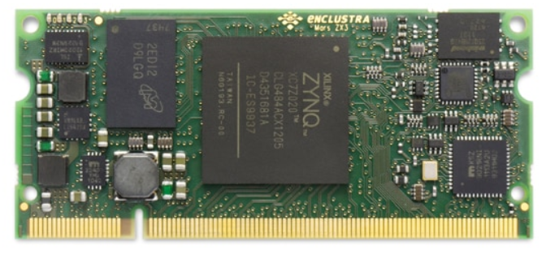
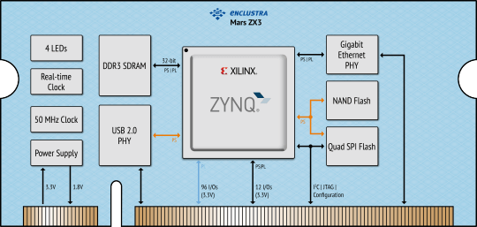
Zynq-based hardware
The design is tested on evaluation boards (like z-turn) and once works correctly, will be fabricated on a custom board

Slide 17
SoC Challenges
Productivity gap
Time-to-market pressure
Difficult verification due to increasing complexity
Difficult timing closure due to deep submicron
Difficult integration due to various levels and areas of expertise
Solution:
System-level Design and Block-based design with reusable IPs

Slide 18
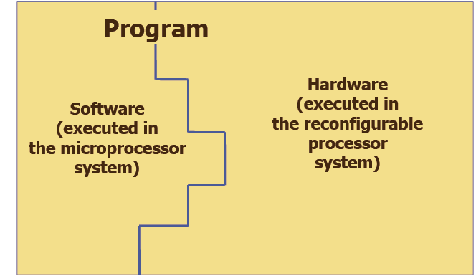
System-level design

Slide 19
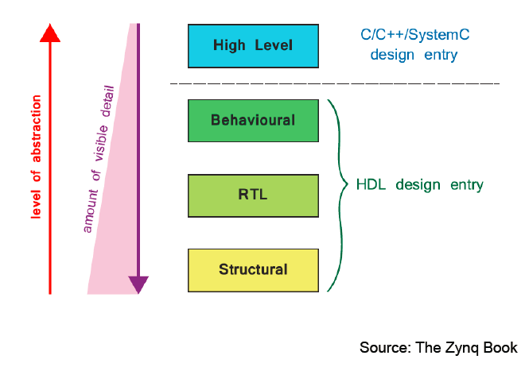
System-level (high-level) design

Slide 20
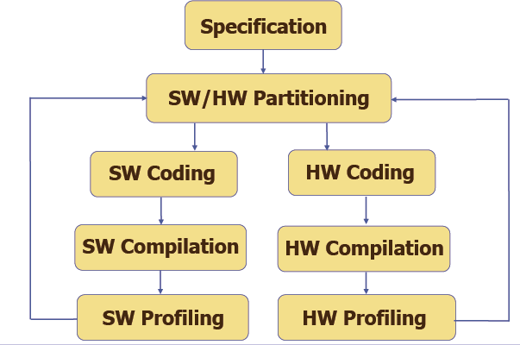
Traditional approach to design
Two different procedures for hardware and software

Slide 21
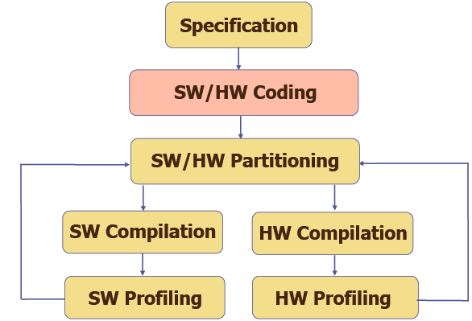
New approach to design: system level
Hardware/software codesign

Slide 22
System-level languages
C-Based System level languages
  SystemVerilog
  Handel C -- Celoxica Ltd.
  SystemC -- The Open SystemC Initiative
Matlab-based
  AccelChip DSP Synthesis -- AccelChip
  System Generator for DSP -- Xilinx
Java-based
  Forge -- Xilinx

Slide 23
Design reuse
Using IP-cores
  “IP” means “intellectual property”
  Circuit designs cleaned up and made available to other engineers
IP examples:
  Microprocessor cores
  DSP cores
  Ethernet, USB, FireWire, 802.11 cores
  Special-purpose cores
    MPEG-2 compression, decompression, encryption cores, filters,etc…
The global semiconductor IP market was valued at $3,434 million in 2017, and is projected to reach $5,701 million by 2024

Slide 24
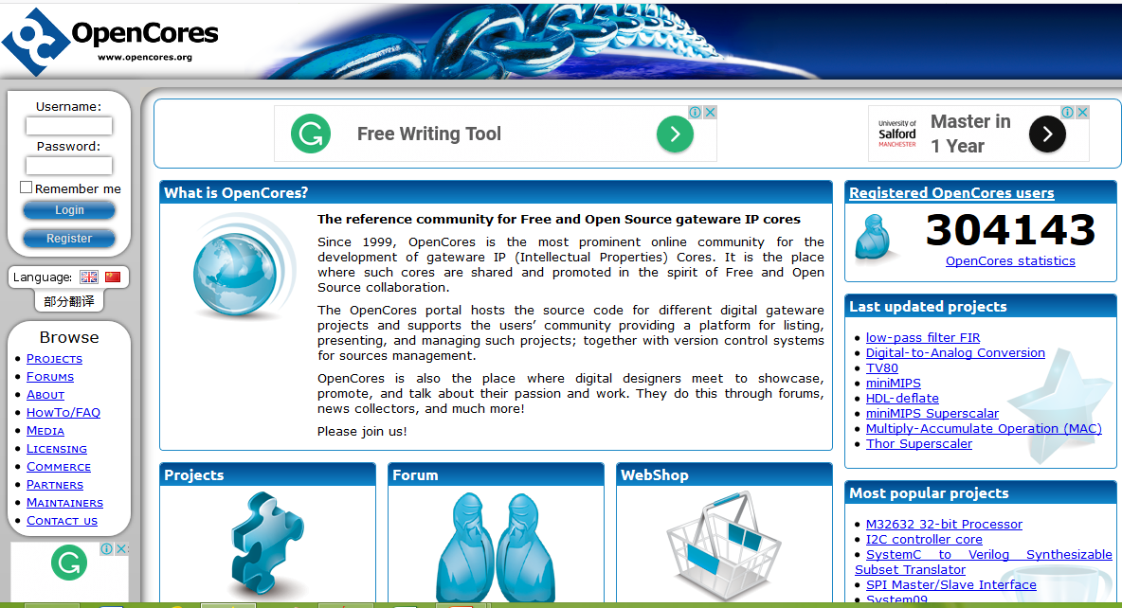
Open IP cores on the internet

Slide 25
Hard IP-cores
Delivered in physical form
Fully designed, placed and routed, and characterized for timing, power, etc.
Tied to a manufacturing process
Actual physical layout
  Fixed shape
Technology specific layout
  Size and speed determined

Slide 26
Soft IP-cores
Circuit design delivered in “source code” format instead of physical film or physical-layout information
  In forms of RTL code or netlist
  technology dependent gate-level netlists are called firm-core
Functions are fixed, may be parameterizable
  Size and shape are determined when synthesizing
Equivalent to delivering C source code
  The program doesn’t change at all, only the details of the executable binary you create

Slide 27
IP core generation
can be done in many commercial tools
  Xilinx CORE Generator System
  Matlab HDL Coder
We can use IP cores by some tools
  Vivado® IP Integrator from Xilinx
  Qsys from Altera

Slide 28
A modern Set Top Box
Cable Modem compliant
Digital Video Broadcast compliant
MPEG-2 Video and AC-3 Audio Decoding
NTSC/PAL/SECAM TV Encoder
RAM and Hard Disk Interfaces
Graphics Accelerator for gaming, internet content, etc.
High Speed Interfaces: USB 2.0 and 10/100 Ethernet
UART, IR, V.90 Modem, SmartCard and GPIO

Slide 29
A modern Set Top Box
Cable Modem compliant
Digital Video Broadcast compliant
MPEG-2 Video and AC-3 Audio Decoding
NTSC/PAL/SECAM TV Encoder
RAM and Hard Disk Interfaces
Graphics Accelerator for gaming, internet content, etc.
High Speed Interfaces: USB 2.0 and 10/100 Ethernet
UART, IR, V.90 Modem, SmartCard and GPIO

Slide 30
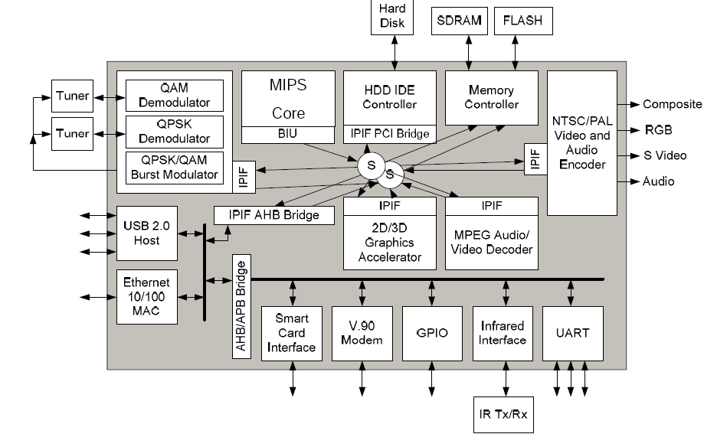
A modern Set Top Box

Slide 31
Embedded Software (eSW)
Embedded SW content in SoC is increasing significantly
eSW: Current application complexity
– Set-top box: >1 million lines of code
– Digital audio processing: >1 million lines of code
In multimedia systems
– SW cost (programs and licenses) 6X larger than H/W chip cost
HW/SW co-design, co-verification issues are important

Slide 32
Tutorial- reusing IP-cores
Keyboard and LCD driver IP cores
Some existing free IP-cores can be selected to be used to design and implement an embedded system
  The cores can be either selected from the free cores included in Xilinx tools or be picked up from some free IP-core websites, such as www.design-reuse.com or opencores.org

Slide 33
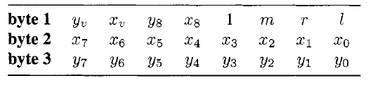
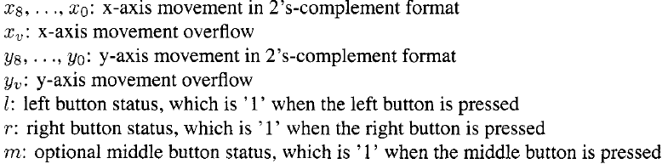
Mouse data packet format
9-bit signed integer to monitor mouse’s movement
  A positive number indicates the right or up movement, and a negative number indicates the left or down movement
Byte 1 is sent first and Byte 3 is sent last

Slide 34
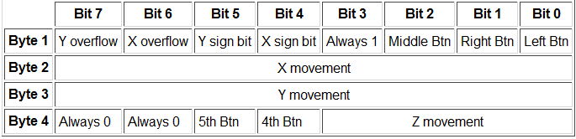
5-button Microsoft Intellimouse
4-byte movement data packet when 5 buttons are used
The Z-movement is the scrolling wheel's movement

